Slide 1
Introduction to Clustering

Slide 2
Agenda
Introduction to Unsupervised Learning
What is Clustering?
K-Means Clustering: theory and implementation
K-modes clustering
Hierarchical Clustering
Linkage method
Dendrogram
Evaluation metrics
Cophenetic Correlation
Silhouette coefficient
Interpreting clusters
Application of clustering
Summary

Slide 3
Unsupervised learning
Dataset does not have labels/Target
Learning is not supervised
Model takes variables as input and either transforms them into another type of features or a value that can be used to solve practical problems.
Techniques
Clustering
PCA, Association
GAN’s, Autoencoder

Slide 4
Use of Unsupervised Learning
Can be used as an exploratory technique to discover hidden structure and patterns of the data.
Can be used to decide whether there is a need to separate models representing each cluster.
Helps is simplifying the data representation.
Can be used for feature engineering through the centroid methods.
Can be used to find useful features for categorization.
Can be used to detect anomalous data points that do not fit into either group.
Used for density estimation in statistics.

Slide 5
Clustering
Used to discovers hidden structure and patterns in uncategorized data.
Finds natural clusters ( groups) existing in the data.
Number of clusters and their granularity can be adjusted.
Notes:
Diagram created Internally

Slide 6
Types of Clustering
Clustering
Hierarchical Clustering
Non Hierarchical Clustering
Agglomerative
Divisive
K-Means
DBSCAN

Slide 7
Distance Calculation
Clustering methods attempts to group the objects based on the definition of similarity specified.
The definition uses distance calculation for the same, lesser the distance, more similar the objects.
Degree of similarity (or dissimilarity) between the data points is a key to achieve the goal of clustering.
Some example of distance calculation are:
Euclidean distance
Manhattan distance
Jaccard distance
Cosine distance
Euclidean distance is highly influenced by scale of each variable.

Slide 8
K Means Clustering

Slide 9
K-Means Clustering
Centroid based model
Non-hierarchical clustering
Considers that clusters are disjoint and there is no hierarchical relation between them
K ( number of cluster) should be specified
K ranges from 1 to n ( number of data points)
Model clusters data into K clusters by segregating data into group of equal variance, minimizing within cluster sum of error ( inertia).

Slide 10
K-Means implementation steps (1/2)
We specify a value for K.
K centroids are randomly computed in the feature space
Let’s say K =3 then C1, C2, C3 will be three clusters.
The distance from each example x to each centroid c using some distance metric is computed.
So, if you have 3 clusters and 25 data points then it will return an array of [25,3] distances.
Before K-Means
Notes:
Diagram created Internally

Slide 11
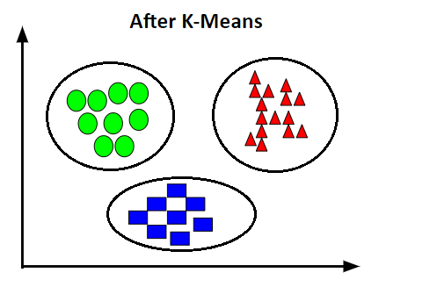
K-Means implementation steps (2/2)
The closest centroid is assigned to each example:
This step will return an array of 25 numbers which are the distances of 25 points from their nearest cluster.
The above distances is used to calculate the error/interia.
New centroid are updated by computing centroids of the previous clusters.
Above steps are repeated until the assignment of data points do not change after the centroids were recomputed.
Notes:
Diagram create internally

Slide 12
Computing K means, Example
Consider 4 data points A,B,C,D as below
 | X1 | X2
A | 2 | 3
B | 6 | 1
C | 1 | 2
D | 3 | 0
2. Let’s choose K=2 and select two centroids P and Q, calculated as, P= Average of A,B. Initial centroids can be random as well.
 | X1 | X2
P | 4 | 2
Q | 2 | 1
Notes:
table created internally

Slide 13
Computing K means, Example
3. Calculate squared euclidean distance between all data points to the centroids P, Q.
For example distance between A(2,3) and P (4,2) can be given by s = (2–4)² + (3–2)².
 | A | B | C | D
P | 5 | 5 | 9 | 5
Q | 4 | 16 | 2 | 2
Notes:
table created internally

Slide 15
Computing K means, Example
5. There are two clusters formed so far, let recompute the centroids with newly assigned data points. (Repeat Step-2)
 | X1 | X2
P | 6 | 1
Q | 2 | 1.67
6. As we know K-Means is iterative procedure now we have to calculate the distance of all points (A, B, C, D) to new centroids (P, Q ) similar to step 3.
 | A | B | C | D
P | 20 | 0 | 26 | 10
Q | 1.78 | 16.44 | 1.11 | 3.78
Notes:
table created internally

Slide 16
Computing K means, Example
7. In the table, we do not see a change in the distance of data points from two clusters. We can say that model has converged.
8. So, we end up with two clusters, where cluster P has one data point and cluster Q has the remaining three data points.
Notes:
table created internally

Slide 17
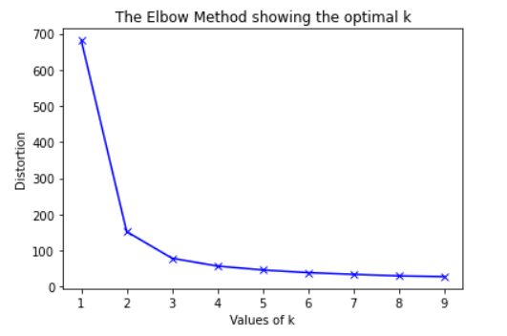
Optimal K
Elbow method is used to determine optimal K.
It measures homogeneity or heterogeneity within clusters as the number of clusters change.
One way is to minimize sum of squared errors in each cluster.
Distortion is the mean of the squared distance from the centroid of the corresponding clusters.
For each value of k calculate the values of distortion and compute the distortion score.
Here, we can choose K=3 as after 3 the drop in distortion is not significant
Notes:
Graph created internally

Slide 18
Advantages and disadvantages
Advantages | Disadvantages
Easy to understand and implement K clusters helps us in labelling the data Distance calculation is simple Helps to eliminate subjectivity from the analysis | Computationally intensive Deciding K can be challenging Using correct distance metric can be a challenge Scaling is required Sensitive to the starting position of initial centroid Susceptible to curse of dimensionality

Slide 19
Let’s answer some questions
What are some Stopping Criteria for k-Means Clustering?
What is the difference between k-Means and k-Nearest Neighbours?
What is the Objective Function of k-Means?
Is k-Means a suitable method when the features are categorical or binary in nature?
Notes:
We can follow below criterias:-
Convergence. No further changes, points stay in the same cluster.
The maximum number of iterations. When the maximum number of iterations has been reached, the algorithm will be stopped. This is done to limit the runtime of the algorithm.
Kmeans is unsupervised and it makes k cluster using centroid based method. KNN is a supervised algorithm which considers K closest neighbors for deciding the class of a new instance
The objective of K-Means clustering is to minimize total intra-cluster variance, or, distance function. The objective function of k-means depends on the proximities of the data points to the cluster centroids.
No, as Euclidean distance between categorical features is not a suitable metric. We can use K-modes

Slide 20
K Modes Clustering

Slide 21
What is K Modes Clustering
K Modes clustering is an extension of K means.
It is used when the features are categorical in nature.
As we have seen, K-Means uses distance measures to cluster continuous data. The lesser the distance, the more similar our data points are. It works well for the numerical features.
We can map categorical value to numerical values using one-hot encoding or label encoding and use the same distance measures. However, this mapping cannot generate quality clusters for high dimensional categorical data.
So we can use K Modes algorithm for cluster the categorical data.

Slide 22
How does K Modes Clustering Work
Instead of using the regular distance measures it uses dissimilarities (total mismatches) between the data points
The lesser the dissimilarities the more similar our data points are.
Index | Like Movies | Like Cars | Like Sport
1 | Yes | No | Yes
2 | No | Yes | Yes
3 | No | Yes | Yes
4 | Yes | Yes | No
5 | Yes | Yes | Yes
6 | Yes | No | No

Slide 23
K Modes Example
Lets us look at a sample dataset that has the information about marital status, city, and gender of persons.
We aim to group them based on the available information.
Obs. | Marital Status | City | Gender
1. | Single | Bangalore | Male
2. | Seperated | Mumbai | Female
3. | Married | Delhi | Female
4. | Divorced | Hyderabad | Female
5. | Seperated | Bangalore | Male
6. | Divorced | Mumbai | Female
7. | Married | Delhi | Male
8. | Divorced | Hyderabad | Male

Slide 24
K Modes Example
Step1: Randomly select K unique observations as the initial cluster centers (modes).
Let us proceed by defining the number of clusters K=3.
Let us choose 1, 7, 8 as initial clusters.
Obs. | Marital Status | City | Sex
1. | Single | Bangalore | Male
2. | Seperated | Mumbai | Female
3. | Married | Delhi | Female
4. | Divorced | Hyderabad | Female
5. | Seperated | Bangalore | Male
6. | Divorced | Mumbai | Female
7. | Married | Delhi | Male
8. | Divorced | Hyderabad | Male
Clusters
1. | Single | Bangalore | Male
7. | Married | Delhi | Male
8. | Divorced | Hyderabad | Male

Slide 25
K Modes Example
Step2: Calculate the dissimilarities (no. of mismatches) and assign each observation to its closet cluster.
Iteratively compare the cluster data points to each of the observations.
For similar data points give 0, dissimilar data points give 1.

Slide 26
K Modes Example
Comparing Cluster 1 with observation 1 given 0 dissimilarities.
Comparing Cluster 1 with observation 2 given 3(1+1+1) dissimilarities.
1. | Single | Bangalore | Male
7. | Married | Delhi | Male
8. | Divorced | Hyderabad | Male
1. | Single | Bangalore | Male
7. | Married | Delhi | Male
8. | Divorced | Hyderabad | Male
Obs. | Marital Status | City | Sex
1. | Single | Bangalore | Male
2. | Seperated | Mumbai | Female
3. | Married | Delhi | Female
4. | Divorced | Hyderabad | Female
5. | Seperated | Bangalore | Male
6. | Divorced | Mumbai | Female
Obs. | Marital Status | City | Sex
1. | Single | Bangalore | Male
2. | Seperated | Mumbai | Female
3. | Married | Delhi | Female
4. | Divorced | Hyderabad | Female
5. | Seperated | Bangalore | Male
6. | Divorced | Mumbai | Female

Slide 27
K Modes Example
Similarly, calculate all the similarities and put them in the table as shown and assign the observations to their closet cluster (cluster that has the least dissimilarity)
After step2, the observations 1,2,5 are assigned to cluster1. 3 and 7 are assigned to cluster 2, and 4,6,8 are assigned to cluster 3.
Note: If all the clusters have the same dissimilarity with an observation, assign to any cluster randomly. In our case, the observation 2 has 3 dissimilarities for all the clusters, So we have assigned it to cluster 1.
obs | Cluster 1 | Cluster 2 | Cluster 3 | Cluster Assigned
1. | 0 | 2 | 2 | 1
2. | 3 | 3 | 3 | 1
3. | 3 | 1 | 3 | 2
4. | 3 | 3 | 1 | 3
5. | 1 | 2 | 2 | 1
6. | 3 | 3 | 2 | 3
7. | 2 | 0 | 2 | 2
8. | 2 | 2 | 0 | 3

Slide 28
K Modes Example
Step3: Define new modes for the clusters.
Consider one cluster at a time, for each feature, look for the mode and update the new clusters.
After obtaining the new clusters, again calculate the dis-similarities between the observations and the newly obtained clusters.
Stop when there is no change in the assignment of the observations.

Slide 29
Hierarchical Clustering

Slide 30
Hierarchical Clustering
These methods involve a series of iterations of combining or dividing a group of observations
Hierarchical Agglomerative Clustering - it’s a bottom-up approach to build clusters. Algorithm starts with each point as a cluster and merges nearest objects or clusters until one big cluster is formed.
Hierarchical Divisive Clustering - it’s a top-down approach. It is exactly opposite of the agglomerative hierarchical clustering.

Slide 31
Linkage methods
To decide which clusters should be grouped together (for agglomerative), or where a cluster is to be separated (for divisive), a measure of dissimilarity between pair of observations is required.
Linkage criterion specifies the measure of dissimilarity between pair of observations.
Choice of distance metric and linkage criteria may influence the final results.
The linkage methods work by calculating the distance or similarity between all objects. Then the closest pair of clusters are combined into a single cluster, reducing the number of cluster remaining.
The process is then repeated until there is only a single cluster left.

Slide 32
Hierarchical Agglomerative Clustering
Common inter cluster distance measurement techniques are:
Single linkage: minimum distance between closest data points from the two clusters is considered
Complete linkage: distance between two farthest data points from the two clusters is considered
Average linkage: average distance is considered
Centroid distance: distance between centroid of different clusters is considered
Single Linkage
Average Linkage
Complete Linkage
Centroid Linkage
Notes:
Image created internally

Slide 33
Dendrogram
Dendrograms are used to represent the distances at which the the different clusters meet.
They provide us an idea as to how the clustering looks like diagrammatically.
Dendrograms for the same dataset change based on the method chosen to calculate distance between the clusters ( linkage function) and distance functions.
The main use of a dendrogram is to work out the best way to allocate objects to clusters.

Slide 34
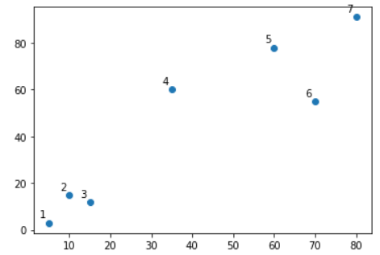
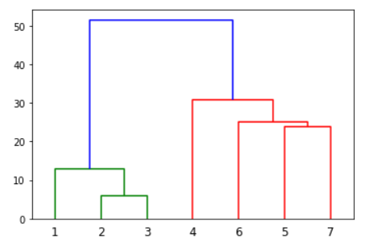
How to interpret a dendrogram?
The y-axis is a measure of closeness of either individual data points or clusters.
Nearest clusters/data points are merged to make a bigger cluster (1,2 and 3 are near to each other).
Similarly cluster 4,6,5 and 7 are close to each other and hence they are made into a bigger cluster.
Horizontal dashed lines at any point on x-axis gives the no. of clusters based on the number of cuts it makes.
Notes:
Image created internally

Slide 35
Computing Hierarchical clustering, Example
Consider one dimensional data set {7,10,20,28,35}
We will perform hierarchical clustering using Single Linkage
In single link hierarchical clustering, we merge in each step the two clusters, whose two closest members have the smallest distance.
Step-1:- compute distance between all pairs.
Step-2: Merge the nearest points. Here, 7 and 10 have the least distance (of 3), and will be merged together
10
8
7
5
3
7 10 20 28 35
1. 7 10 20 28 35
3 10 8 7

Slide 36
Computing Hierarchical clustering, Example
Step-3:- compute distance of all data points from cluster-1 (7,10) using the linkage method. And distance among data points as well.
Step-4: Merge the nearest point in the cluster or create a new cluster of the nearest data points. Here, 28 and 35 have the least distance (of 7), and will be merged together
10
8
7
5
3
7 10 20 28 35
2. (7,10) 20 28 35
10 8 7

Slide 37
Computing Hierarchical clustering, Example
Step-5:- repeat step-3 and step-4:
We merge 20 with cluster-2 (28,35)
Then, we merge cluster-1 (7,10) with the cluster-3 (20,28,35) and get the final cluster with all data points together.
10
8
7
5
2. (7,10) 20 28 35
10 8 7
3. (7,10) 20 (28,35)
10 8
4. (7,10) (20,28,35)
10
3
7 10 20 28 35
Now, we can cut the dendrogram at a suitable place and choose the final number of clusters.
Here, we can go for either 2 or 3 clusters.

Slide 38
Cophenetic correlation
Measure of goodness of fit of dendrograms
The right choice of dendrogram is done by considering a value known as a cophenetic correlation.
Dendrogram Distance - distance between two points/clusters as described by that dendrogram.
Cophenetic correlation computes the correlation between the euclidean distance and the dendrogram distance for a particular dendrogram of all possible pair of points.
Performance measure -
The dendrogram corresponding to highest cophenetic correlation coefficient is considered to be better representative of the clustered data and is used to produce labels/ clusters for the data set.

Slide 39
Silhouette coefficient
Used to study the separation distance between the resulting clusters.
Displays a measure of how close each point is to its own cluster compared to other clusters
Its value ranges from -1 to 1.
1: Means clusters are well apart from each other and clearly distinguished.
0: Means clusters are indifferent, or we can say that the distance between clusters is not significant.
-1: Means clusters are assigned in the wrong way.

Slide 40
Cluster Analysis
How do we interpret clusters?
Once the labels are assigned to clusters, we can analyse then in more detail using statistical and visualisation methods
By checking the statistical summary of the clusters (Ex: Cluster-1 tends to have customers of age less than 30, Cluster-2 has most customer having a higher age)
By doing multivariate analysis between cluster labels and different features (Ex. cluster-1 has more employees with low salary etc.)

Slide 41
Cluster Analysis
Let us take a example:
The Credit card Dataset summarizes the usage behavior of about 9000 active credit card holders for the duration 6 months of a credit card company.
The dataset has the information about the customers such as CustomerID, Balance, Purchases, Tenure, Credit limit and so on….
Using a clustering algorithm have clustered the data into three clusters. The clusters are labeled as 0,1,2
Let us interpret the clusters formed

Slide 42
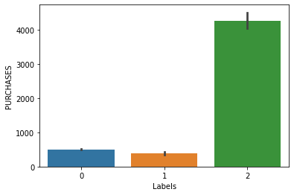
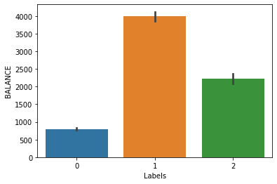
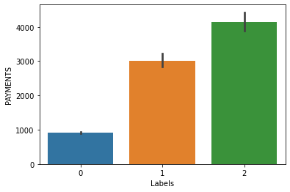
Cluster Analysis
Let us visualize and Interpret the clusters using the bar plots
Cluster 0 does less purchases, have lesser balance and payments are also less compare to clusters 1 and 2
Cluster 1 do less purchases but have maximum balance compare to other two clusters and payments are in average
Cluster 2 does maximum purchases and do maximum payments and has average balance

Slide 43
Applications of Clustering
Customer segmentation
Market research
Recommendation engine
Pattern recognition
Image segmentation
Social network analysis

Slide 44
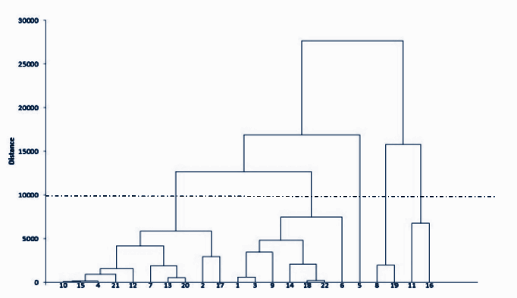
Let’s answer some questions
Why do we need linkage methods? Why can’t we use simple distance measures?
Among K-Means and Agglomerative clustering, which method is computationally heavy?
Consider the below graph for agglomerative clustering, if you draw a horizontal line on the y-axis for y=10000. What will be the number of clusters formed?
Notes:
We want to find distance between clusters. Euclidean distance is used to find distance between two data points. But when we have group of data points, we need a better way to check similarity
Agglomerative clustering. The time complexity of K Means is linear i.e. O(n) while that of hierarchical clustering is quadratic i.e. O(n2)
5. It cuts 5 Vertical lines, all of which represent a cluster.

Slide 45
Summary
In this module we discussed:
Introduction to Unsupervised Learning
What is Clustering?
K-Means Clustering theory
K-Means implementation
K Modes Clustering
Hierarchical Clustering
Linkage method
Dendrogram
Cophenetic Correlation & Silhouette coefficient
Cluster analysis
Notes:
Diagram created Internally

Slide 46
Thank you Happy learning ☺

